Slide 1

RFID based Attendance Monitoring System

Slide 2
Department of Applied Electronics and Instrumentation Engineering
Academy of Technology
Project Guide: Mr. Hiranmoy Mandal
Presented By:
Snehasish Malik (11), Bratati Rout (43), Ahana Das (57),
Debapriya Bose (41), Hirak Das (36), Soumalya Sen (10).

Slide 3
T O P I C S
1
I N T R O D U C T I O N
T H E O R Y
2
3
W O R K I N G
4
C O N C L U S I O N

Slide 4
Literature Survey
Study & Findings
It was found that most organisations uses manual attendance monitoring and many models exists which aim to monitor attendance using RFID technology. The various models are:
Simple attendance logging after verification using only RFID cards.
Logging and monitoring attendance after connecting the RFID reader directly into a server.
Use of GSM to inform parents about the student’s attendance.
Cloud storage and SD card options for backup.
Inference
No methods were used to provide data security.
Logging multiple attendances simultaneously was not possible.
Uses limited infrastructure for covering a very large area.

Slide 5
Objective
Our aim is to provide a model that:
is completely automatic,
is able to log multiple attendance simultaneously,
does not require any manual effort.
helps in monitoring attendance seamlessly.
is not limited by infrastructure.

Slide 6
INTRODUCTION
1

Slide 7

Proposed system
Automates the attendance taking process.
Reduces time and increases efficiency.
Enforces Security.
Scalable, easy to manage and easy to monitor.

Slide 8
Importance of the method
Methods will be implemented to tackle proxy/false attendance.
(LoRa is used to connect multiple SUs to a single MCU, irrespective of the number of SUs). Greater area of connectivity.
(Due to the implementation of multiple SUs, the model is able to handle greater volume of data in less time.) Handles greater volume of data. Enhanced efficiency.
Easily detects failure, at any level and in any case.

Slide 9
THEORY
2

Slide 10
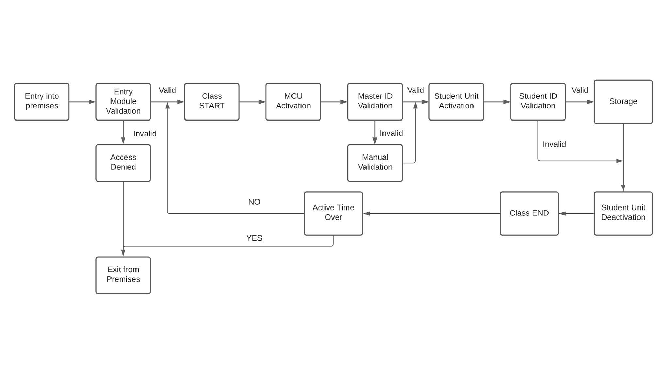
Block diagram of the proposed system

Slide 11
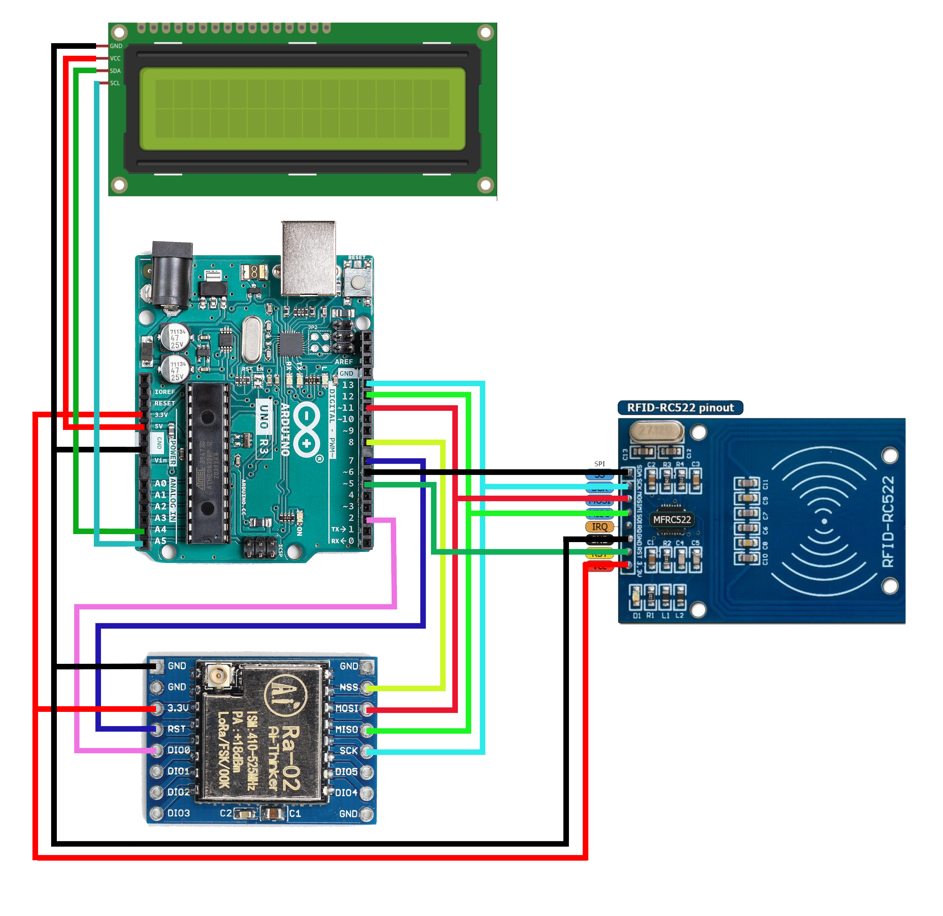
Technology Used
RC522 RFID reader is used for reading information from the RFID tags/cards.
Arduino Uno or Nano is used as the microcontroller.
LoRa is used as the communication layer and protocol.
LCD is used to display the necessary information for visual aid.

Slide 12


RFID
Arduino
Provides an Unique ID.
Line of Sight not required.
Contactless information sharing.
Battery-less operation.
Can detect through obstacles.
Open-source in hardware and software and Inexpensive.
Does not require an external programmer.
Arduino IDE is supported in almost every OS.
Ease of Programming.
A very large and growing community.

Slide 13

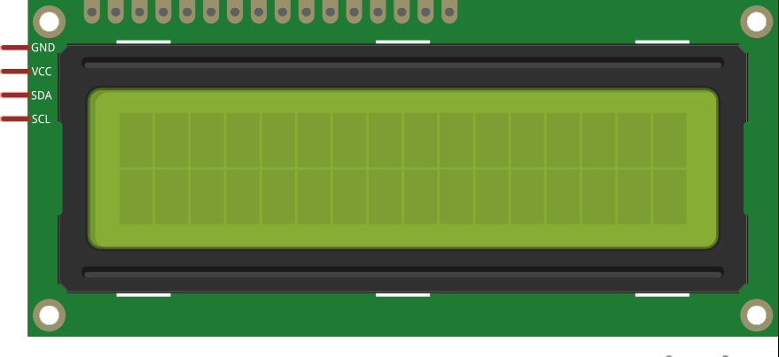
LoRa
LCD
Operates on 433MHz band.
Provides deep indoor coverage.
Low-power.
Low-cost. One unit costs around ₹450.
It is a 16x2 LCD.
Provides visual info.
Uses I2C protocol.
Depicts status of the process.

Slide 14
WORKING
3

Slide 15
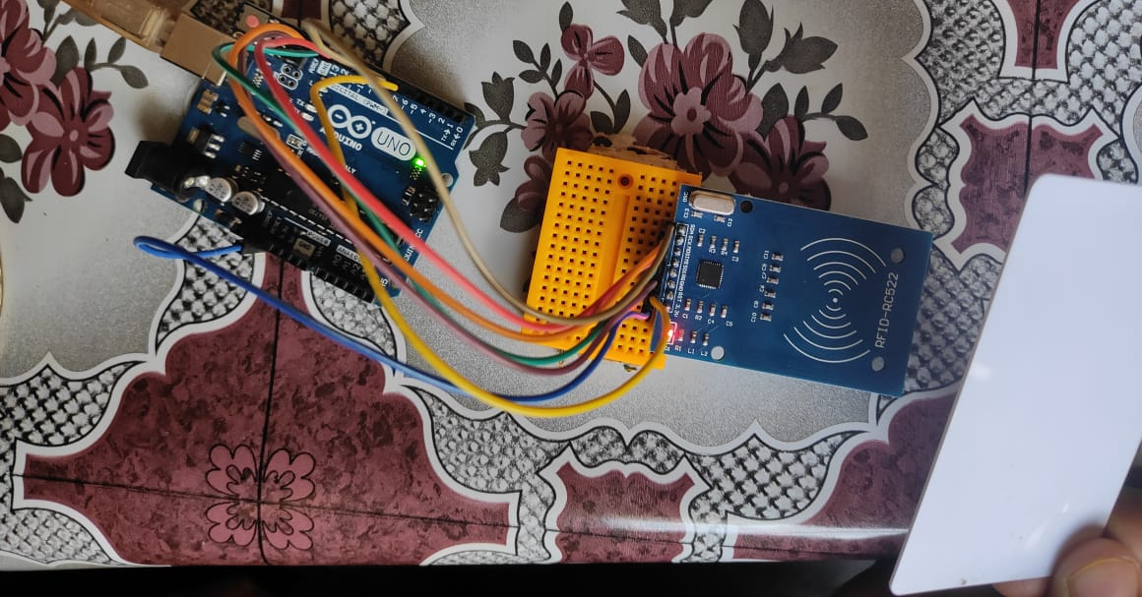
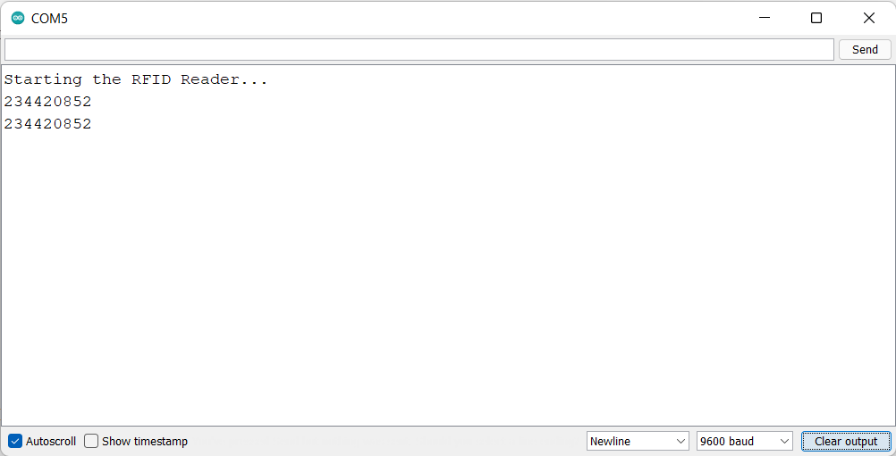
Reading info from the RFID Card
Picture showing the RFID reader detecting and printing the Tag value.

Slide 16
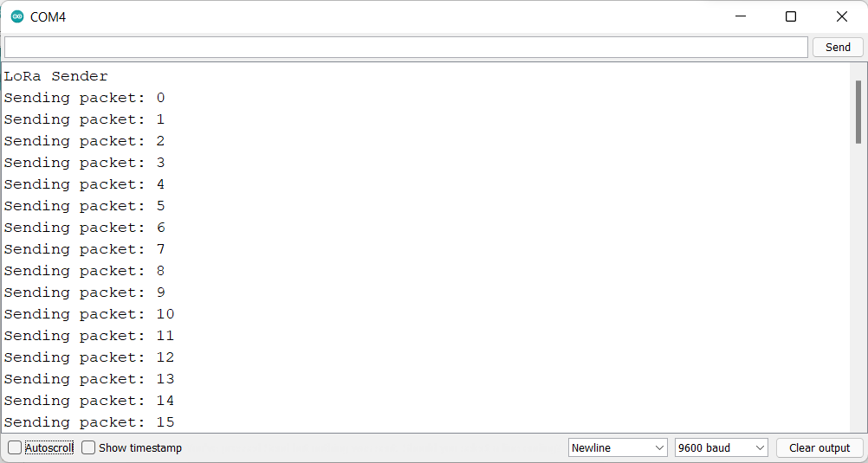
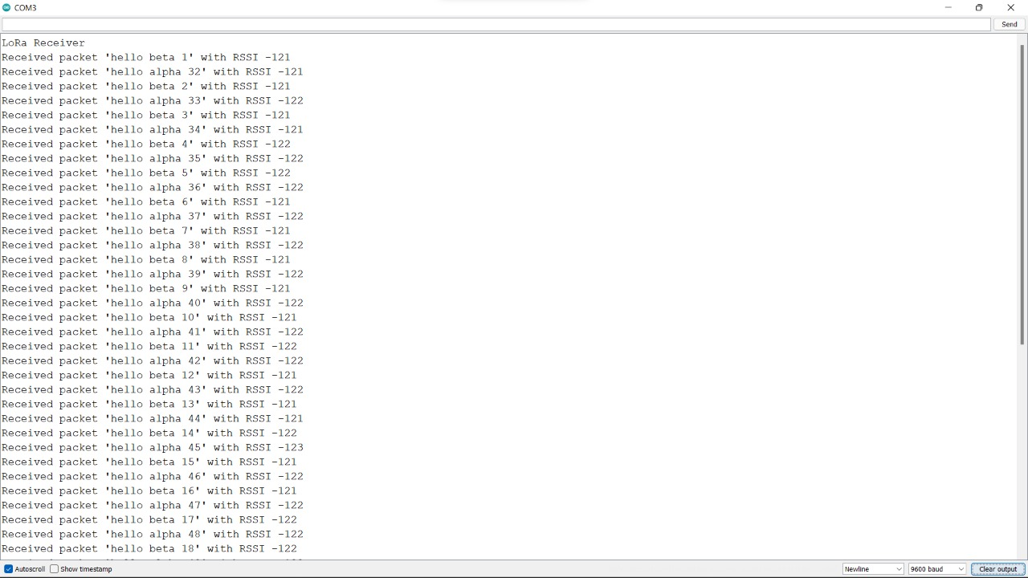
Communicating using LoRa
The LoRa module is used to send and receive data packets to and from end nodes.
The same is shown below:
Figure showing LoRa sending data packets
Figure showing LoRa receiving data packets

Slide 17
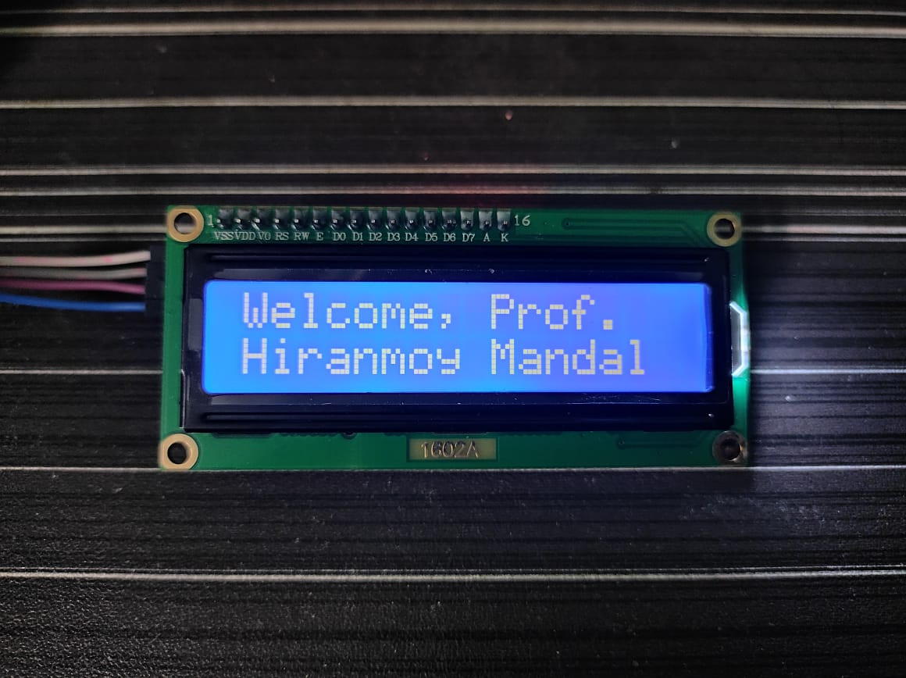
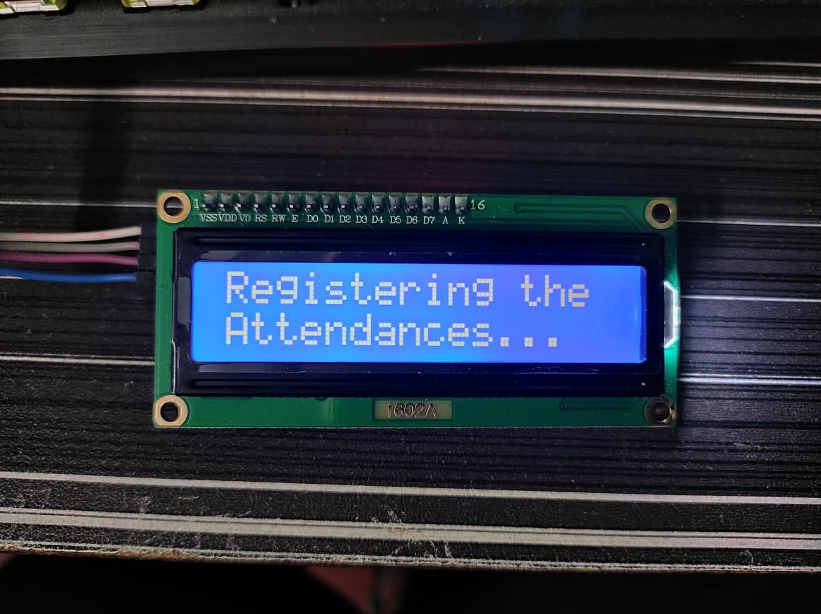
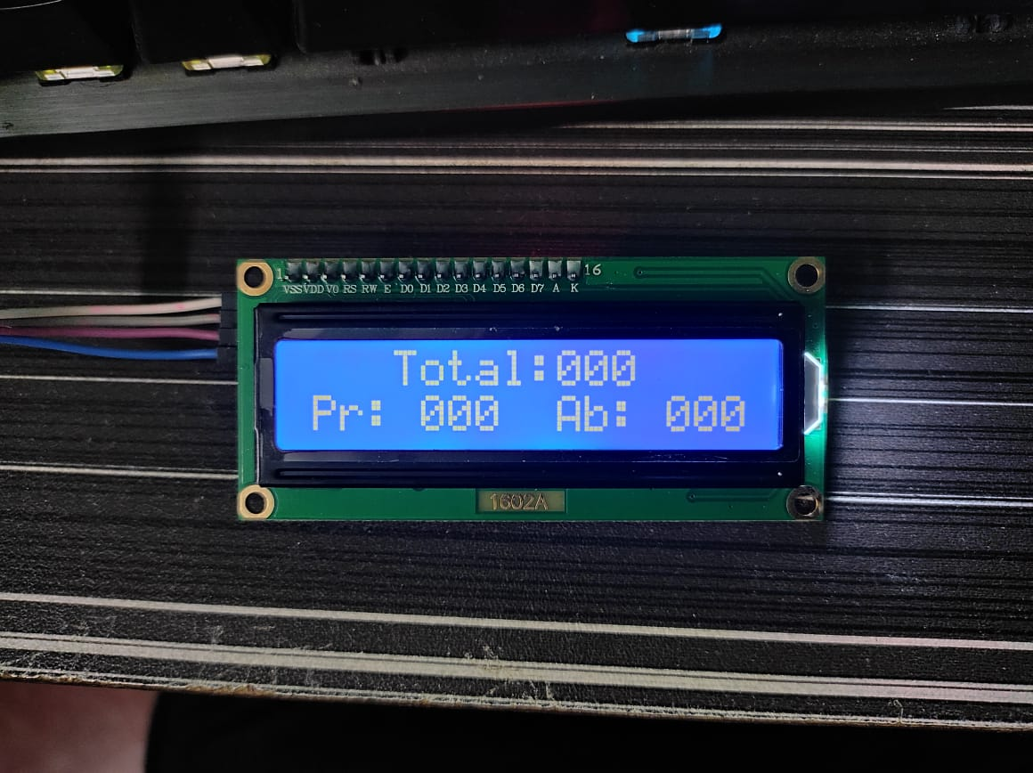
Customising the LCD
We are able to customise the LCD based on our needs like:
Displaying a Welcome message.
Status of the process.
Necessary numbers and values.

Slide 18
Master Control Unit
The Master Control Unit will have an Arduino Uno, RC522 reader module, LoRa Ra-02 module and I2C LCD module.
The Master Control unit is responsible for the whole process.
The Master Control Unit is capable of showing the vital information at that time .
The task performed by MCU is explained in the next slide.

Slide 19
Process
The teacher starts the MCU.
The teacher is greeted .
All the SUs will be activated.
All the students data is collected and stored in the respective database.
The attendance is confirmed and the process ends.

Slide 20
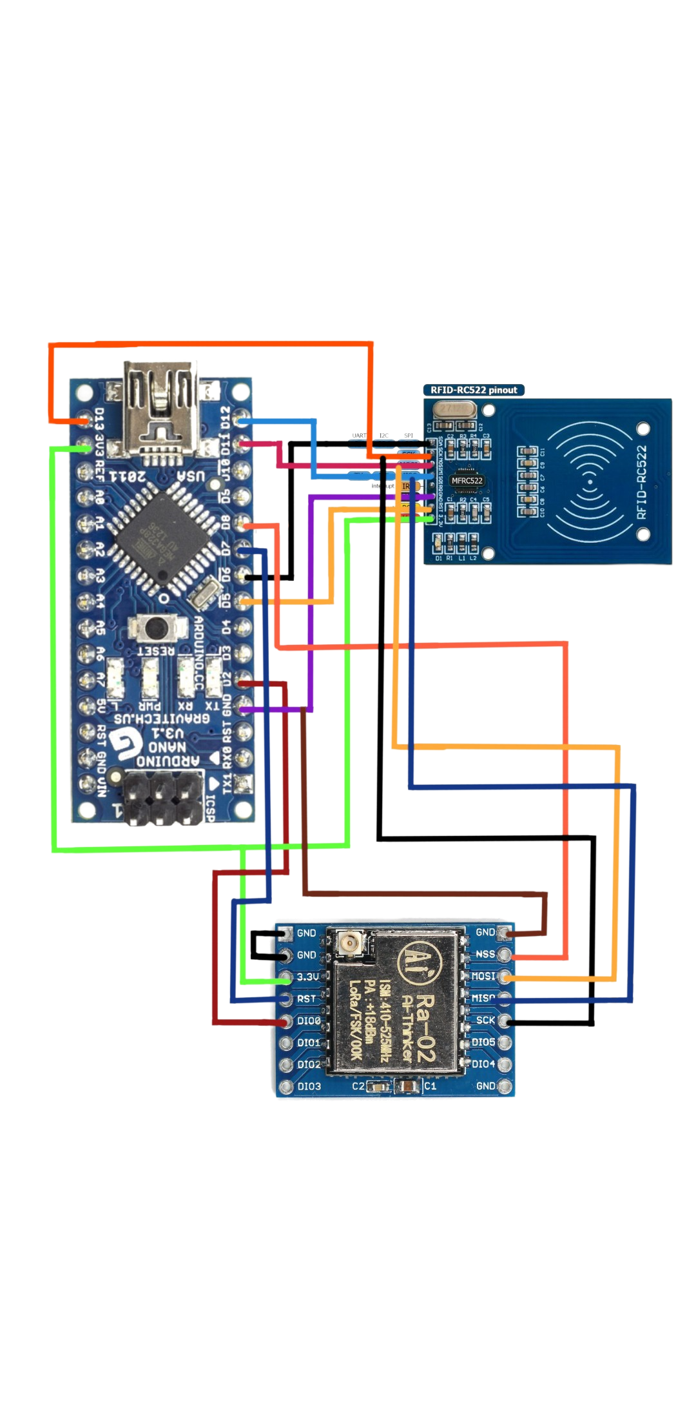
Student Control Unit
The Student Unit mainly comprises the Arduino Nano, RC522 RFID reader module and Ra-02 LoRa module.
This is done to collect the Information from the student’s ID card when taking the attendance and to transmit that information to the Master Control Unit for further processing.

Slide 21
Process
Student places the ID card
Transmits the data to the MCU
MCU sends back the confirmation
Attendance process ends

Slide 22
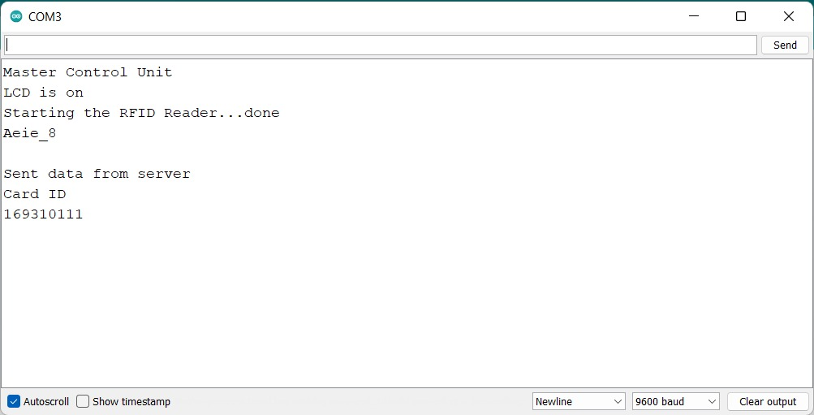
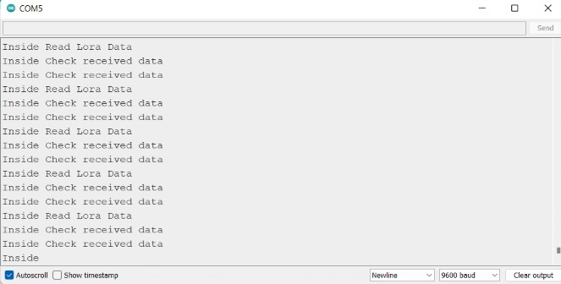
Simultaneous Working of MCU and SU

Slide 23
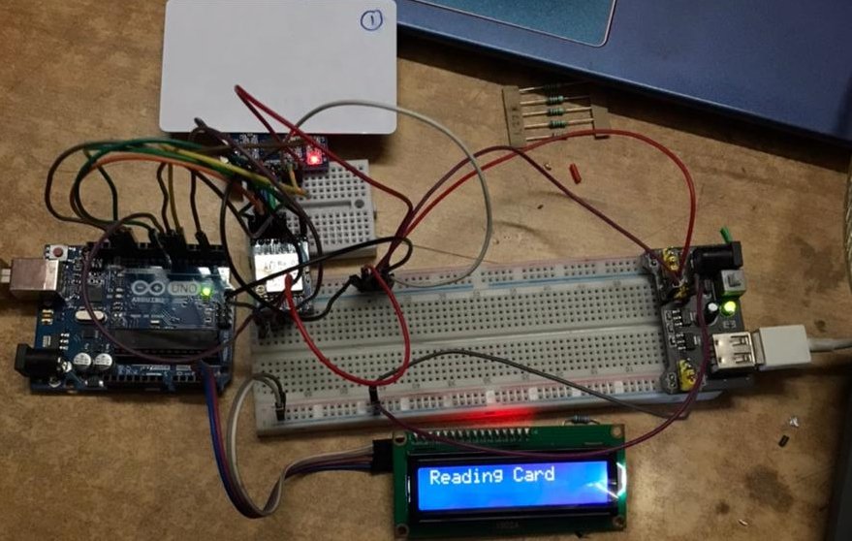
Pictorial Representation :

Slide 24
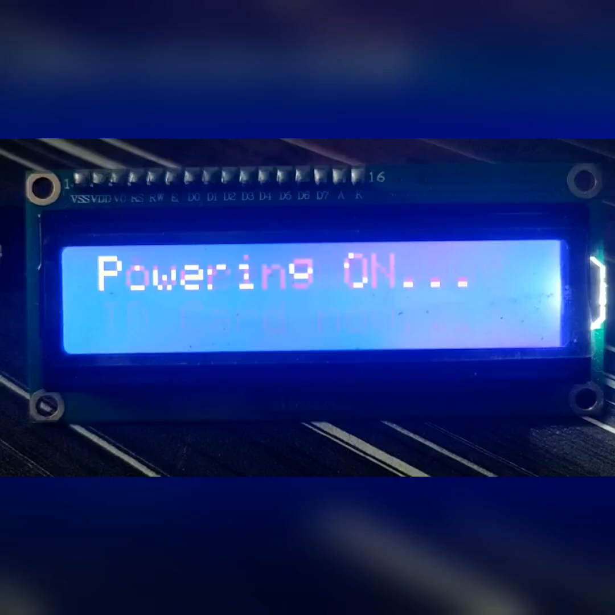
Video Representation :

Slide 25
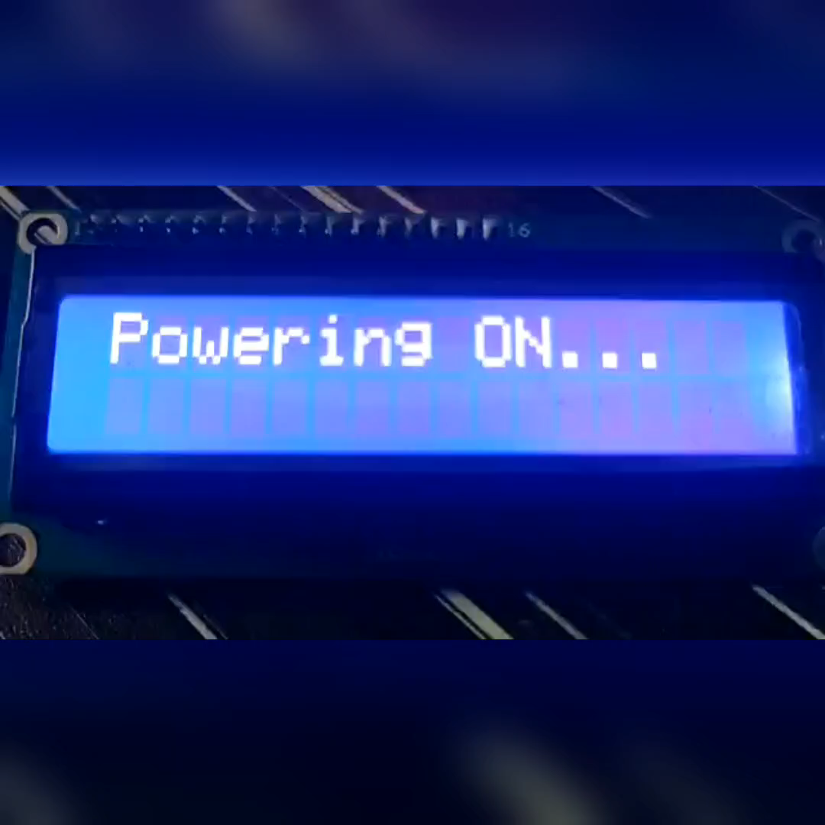
Video Representation :

Slide 26
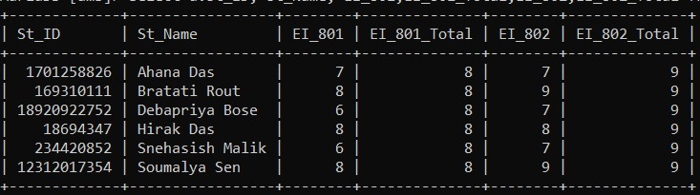
Database Table

Slide 27
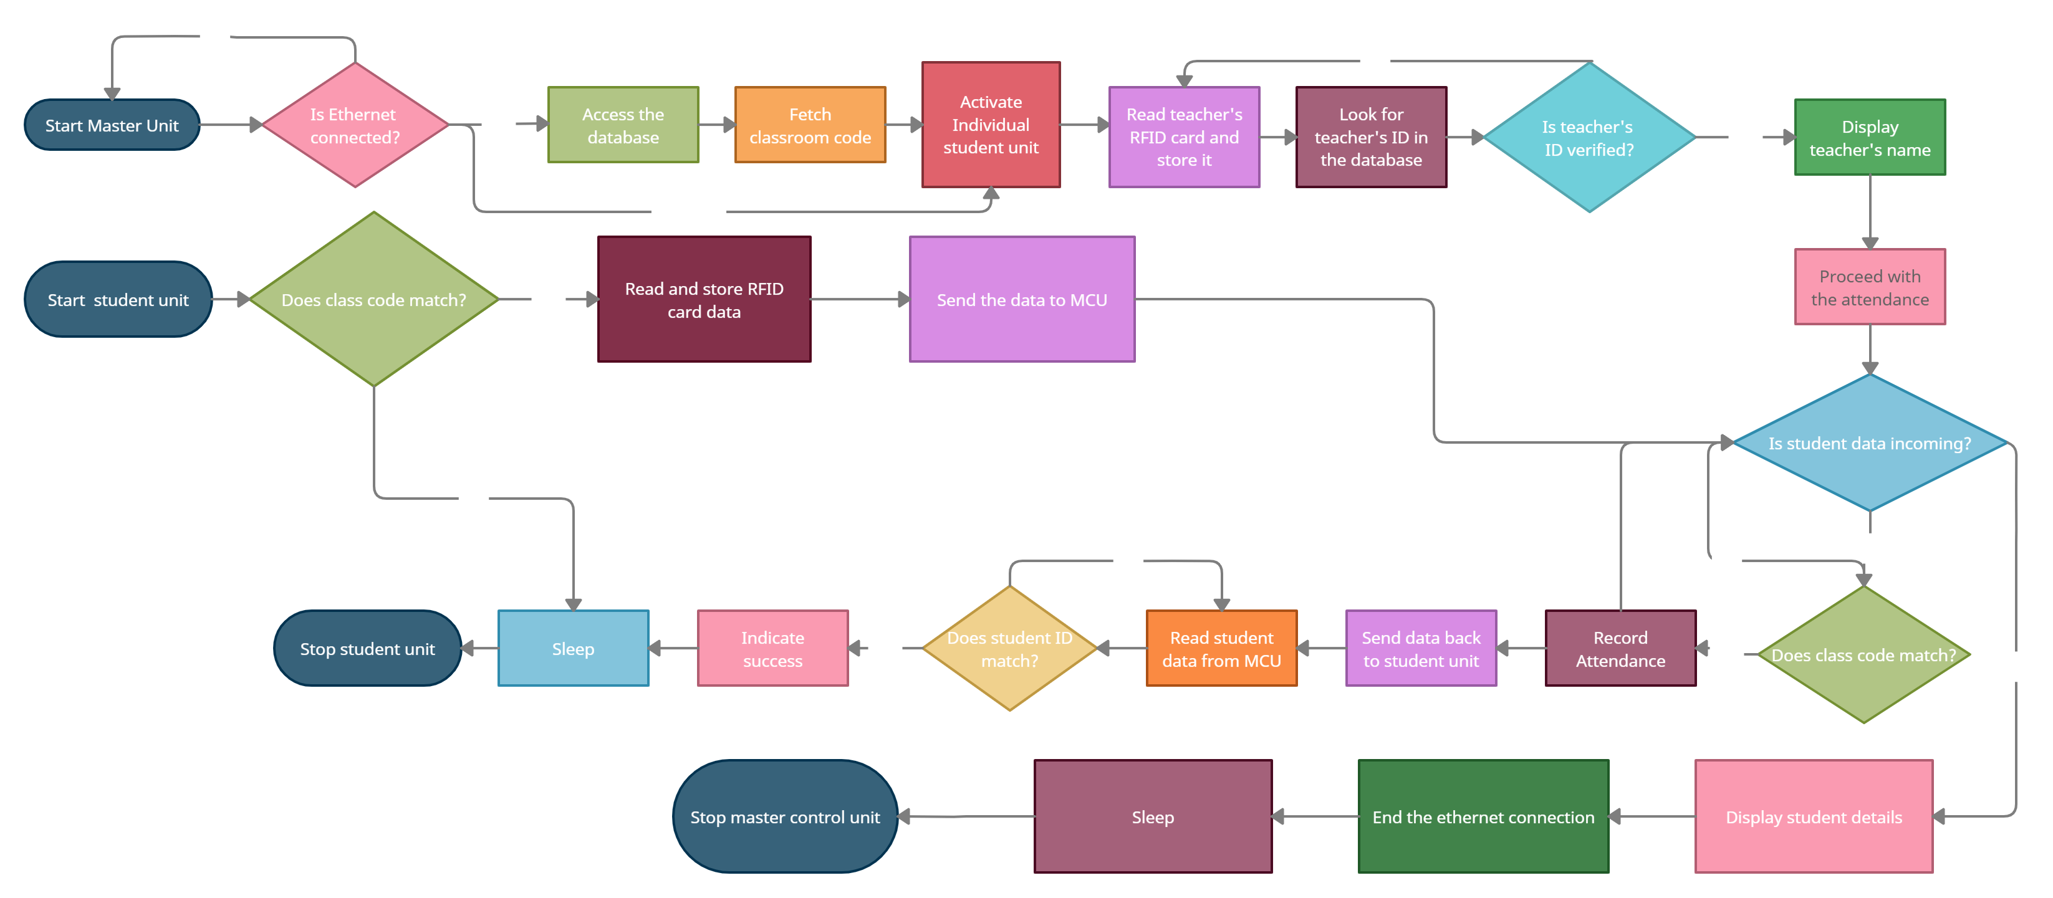
Flowchart of the process

Slide 28
CONCLUSION
Automation
Saves time.
Reduces errors.
Less human effort.
Low Cost
Most of the components and software are open-source.
Relatively cheaper than other comparable/similar technologies available.
Better Operability
Simple Interface.
Easy to use & operate.
Abstract design.
Advantageous
Digitalization of data.
Low response time.
Simultaneous registering of attendance.
Low maintenance
Battery operated.
Very low power consuming components and techniques.
Future Scope
Adopt in other organisation to cater their needs.
Include parts to enhance or change certain requirements.

Slide 29
References
Gatsheni, B.N., R.B. Kuriakose, and F. Aghdasi. Automating student class attendance register using radio frequency identification in South Africa, in Mechatronics, ICM2007 4th IEEE International Conference in 2007.
Mahyidin, M.F. Student Attendance Using RFID System 2008; Available from: http://umpir.ump.edu.my.
T. S. Lim, S.C. Sim, M. M Mansor. RFID Based Attendance System. 2009 IEEE Symposium on Industrial Electronics and Applications (ISIEA 2009), Kuala Lumpur, Malaysia, October 4-6, 2009.

Slide 30
THANK YOU 🤝

